Slide 1
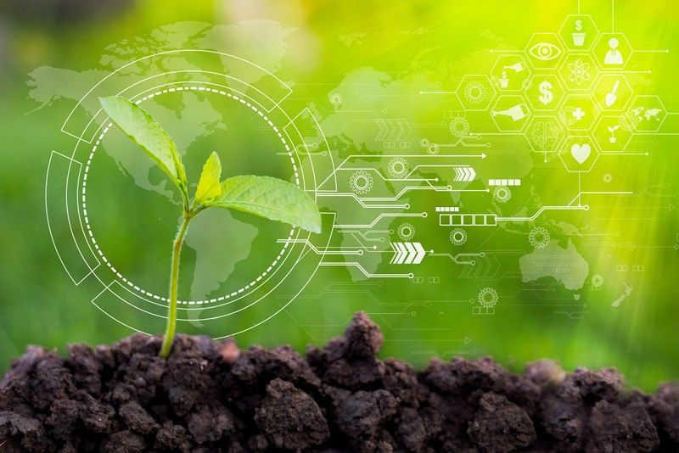
SMART WATERING SYSTEM
Presenter Name

Slide 2
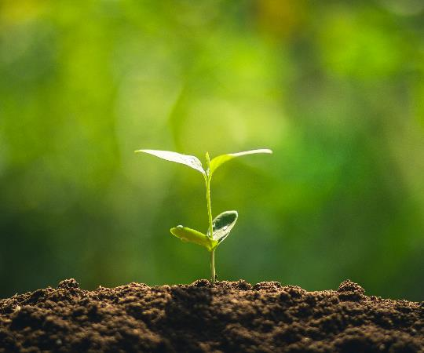
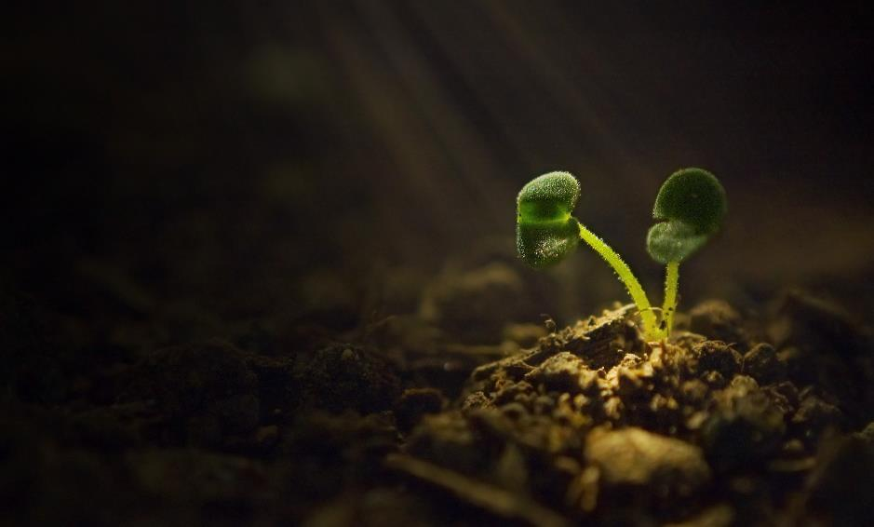
Agenda
Introduction
Problem Statement
Solution
How it works?
Advantages
Challenges
Future Scope
Demo

Slide 3
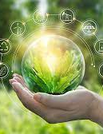
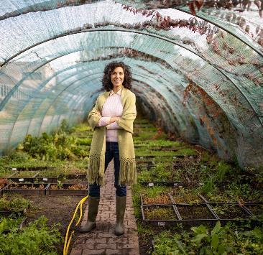
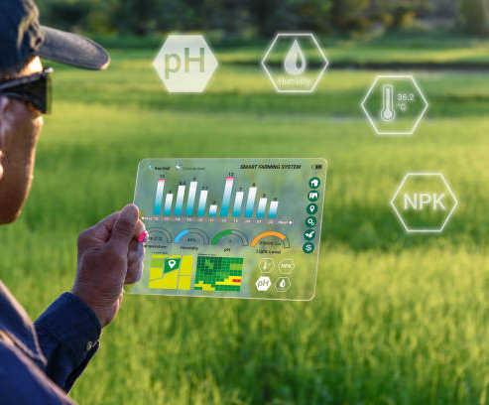
Introduction
Smart Watering System developing model is a real time monitoring system. It monitor the soil properties like soil moisture etc.
It offers a futuristic way of life in which an individual gets to control his electronic devices using a smart phone

Slide 4
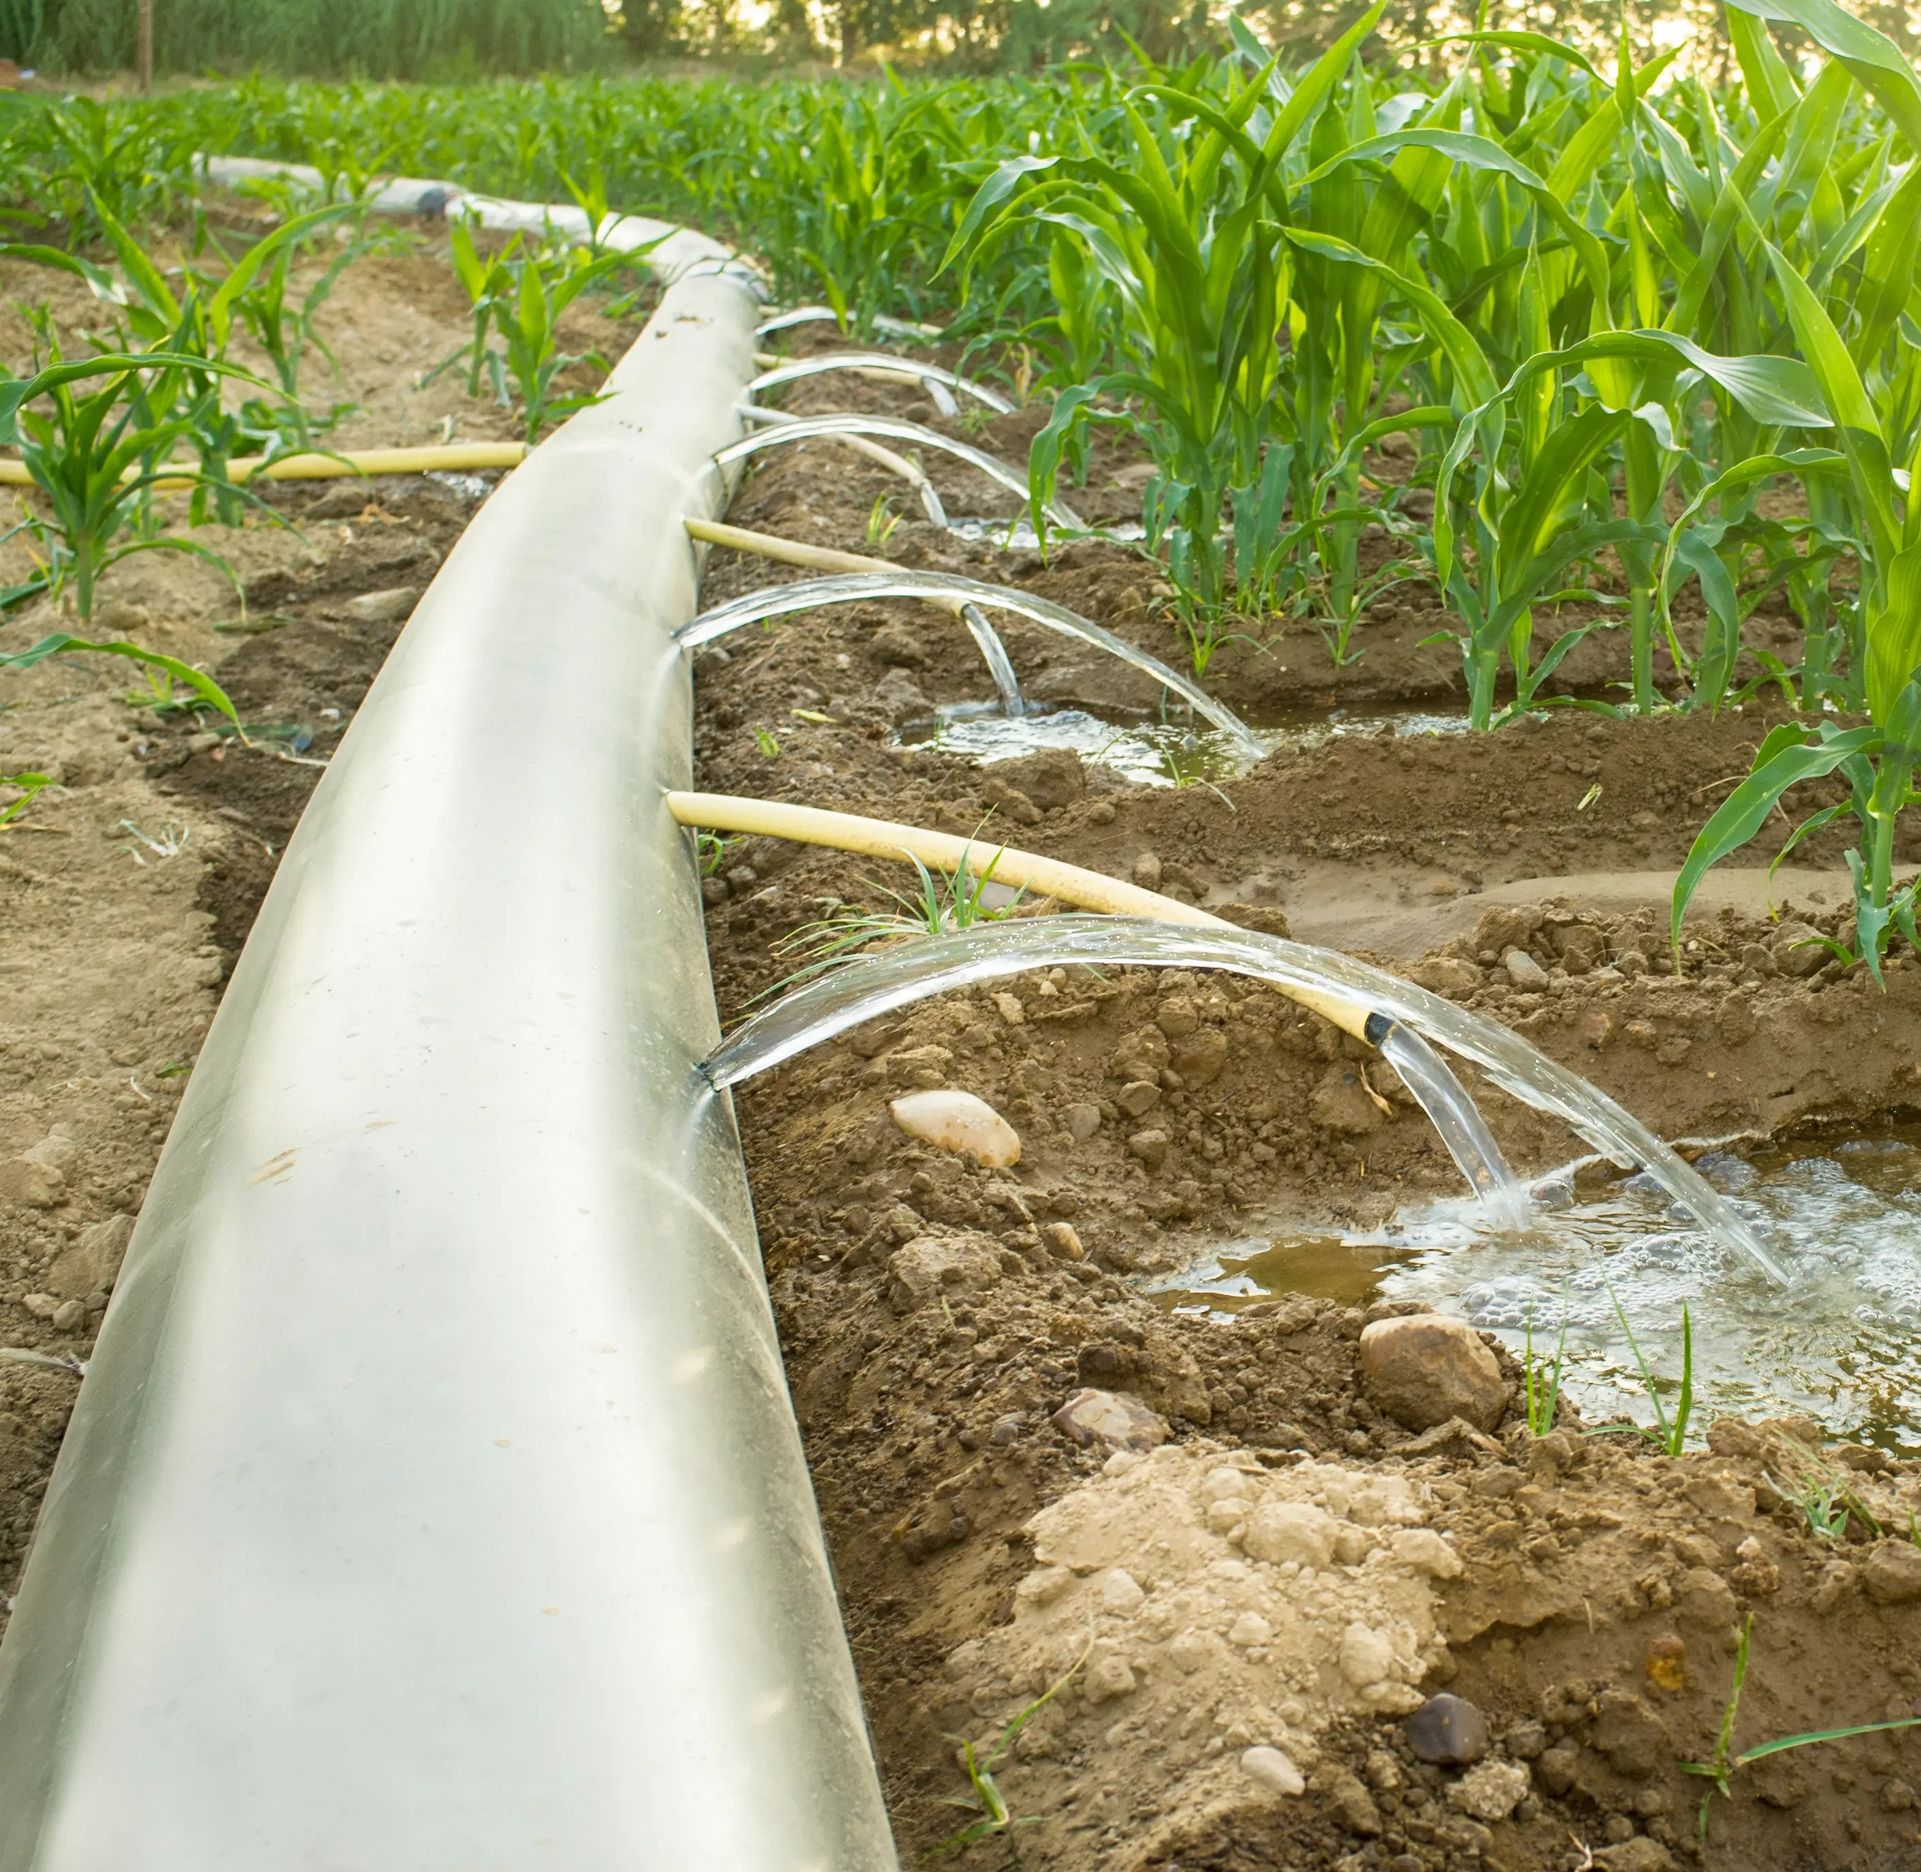
Problem Statement
Farmers face problem in over watering the crop if they miss switching off the motor, which may lead to crop damage and water wastage.

Slide 5

SOLUTION SMART WATERING SYSYTEM
The Solution is Smart watering System. In this System, the crop is watered according to its requirement, without the farmer.
Soil Moisture is detected from the crop. Based on the Moisture percentage, the motor will turn on and off automatically. And this can be visualized by farmer in a app (Blynk IoT).
The required moisture for that respective crop acts as the threshold_moisture_value to turn on or turn off the motor.

Slide 6
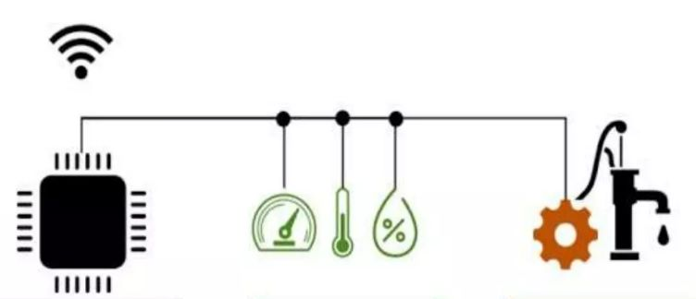

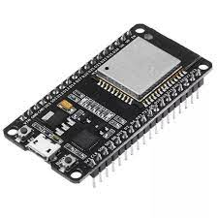
COMPONENTS
IoT
Thristy!
Program ESP32
Connect sensors
Automate Irrigation

Slide 7
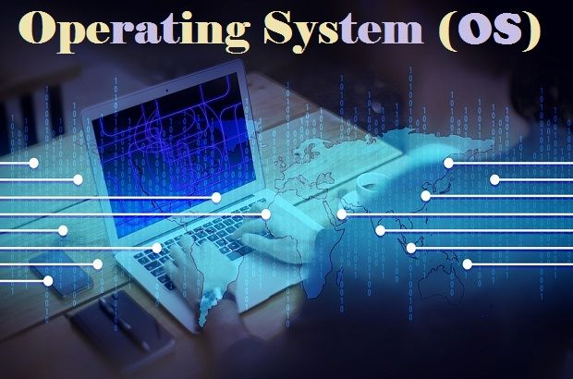
HOW THE SYSTEM WORKS
Start
Read Soil Moisture detector reading
Compare the values
Not Matches
Matches
Turn on/off pump

Slide 8
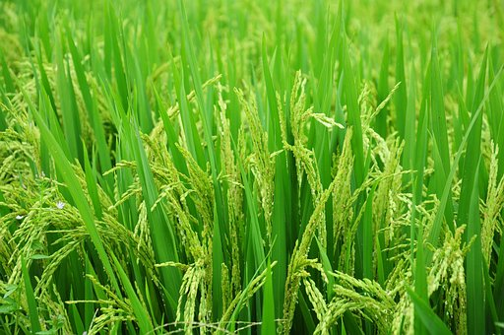
For Example : Paddy Field

Slide 9
Average soil moisture percentages at different stages of paddy crop growth:
1. Land Preparation: around 70-75% of field capacity before planting.
2. Seedling Stage: During the first 25 days after planting, the soil moisture should be kept at around 80-85% of field capacity.
3. Vegetative Stage: From day 26 to around 50 days after planting, the soil moisture should be maintained at around 75-80% of field capacity.
4. Reproductive Stage: From day 51 to around 90 days after planting, the soil moisture should be kept at around 70-75% of field capacity.
5. Ripening Stage: During the last 2-3 weeks of crop growth, the soil moisture should be gradually reduced to around 60-65% of field capacity.
Regular monitoring of soil moisture levels is important to ensure that the crop is receiving the appropriate amount of water at each stage of growth.

Slide 10

ADVANTAGES
Increase in productivity
Reduced water consumption
To Safe to operate
No Manpower required
Reduced soil erosion and nutrient leaching

Slide 11
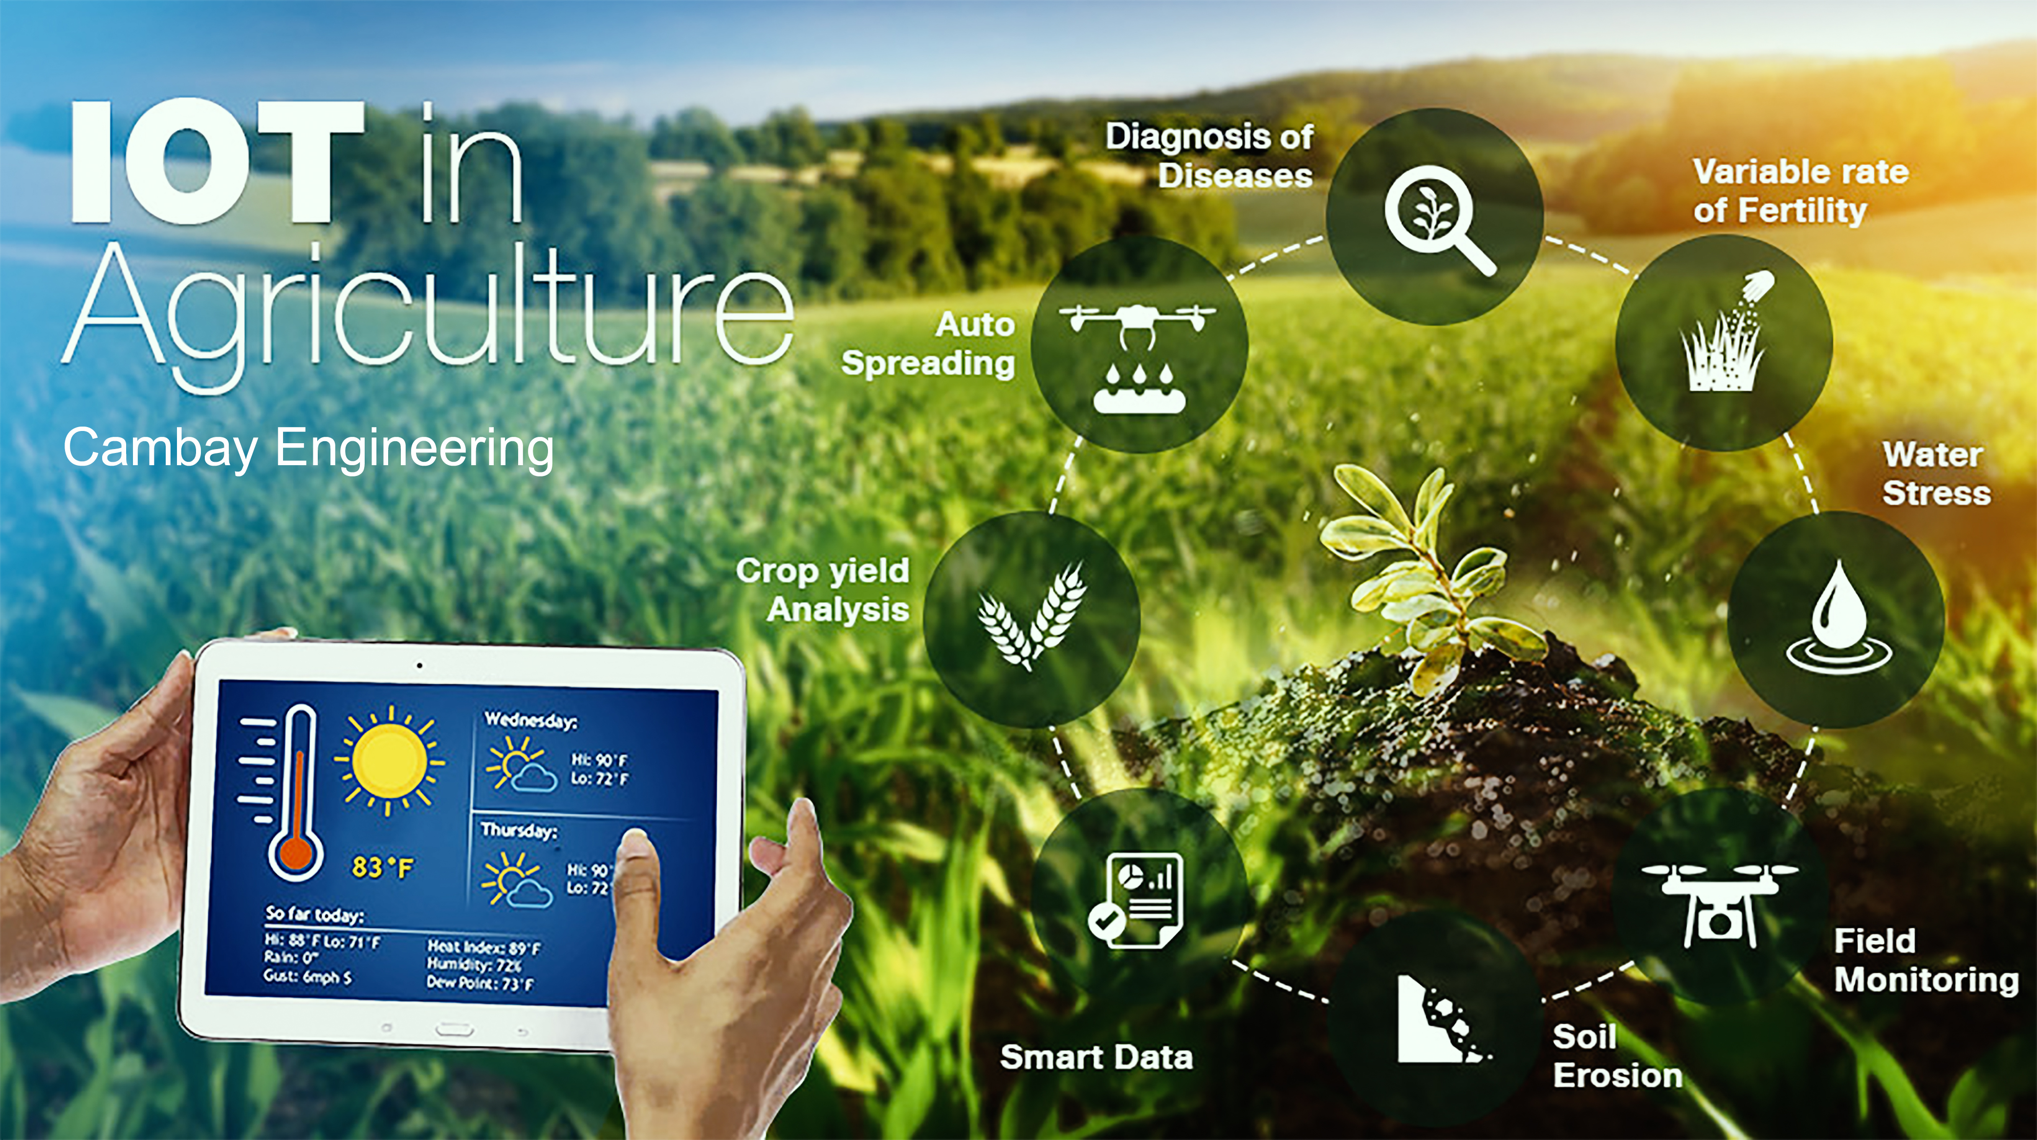
Challenges
The smart farming based equipment require farmer to understand and learn the use of technology
The Smart Watering System need availability on internet continuously.
Fault sensor or data processing engines can cause faulty I decisions which may lead to over use of water, fertilizers and other wastage of resources.
It also has some issues which have to be tracked properly in order to attain the full benefit of it.

Slide 12
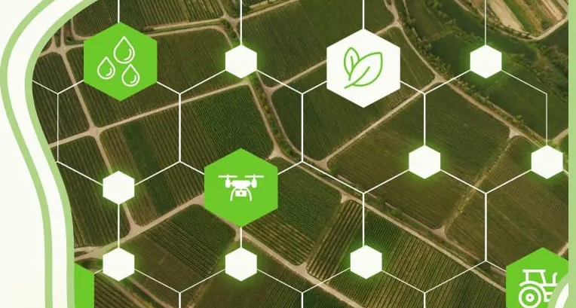
Future Plans
TEMPERATURE AND HUMIDITY DETECTION
RAIN DETECTION
The data detected from the DHT sensor can be stored in a database and do future predictions.
Like, in which season the soil moisture will be more , in that respective temperature and humidity and respective action can be taken by the farmer.
Excess water may damage the crop, when the motor is on, while raining.
Rain drop Sensor will sense the rain and send alert message to farmer and turn off the motor if it is on.

Slide 13
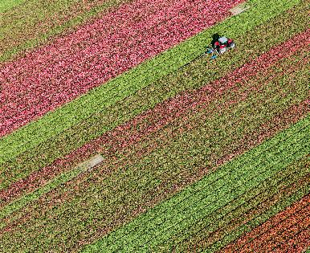
Additional Modules
Obstacle DETECTION
DATA TO CLOUD
GPS TRACK
The crop can also be illegally harvested or taken without authorization, or suffer damage from animal interference.
The PIR Motion Sensor detects any moving object and sends alert message to farmer
The data collected on the serial monitor and Blynk IoT app is loaded to the cloud.
The data can further be modeled and use for future predictions.
If there are any fire accidents on a large farm land, it is difficult for farmer to know the location.
The GPS sensor locates where the fire accident occurred in the large area and it can also be used for other benefits as well.

Slide 14
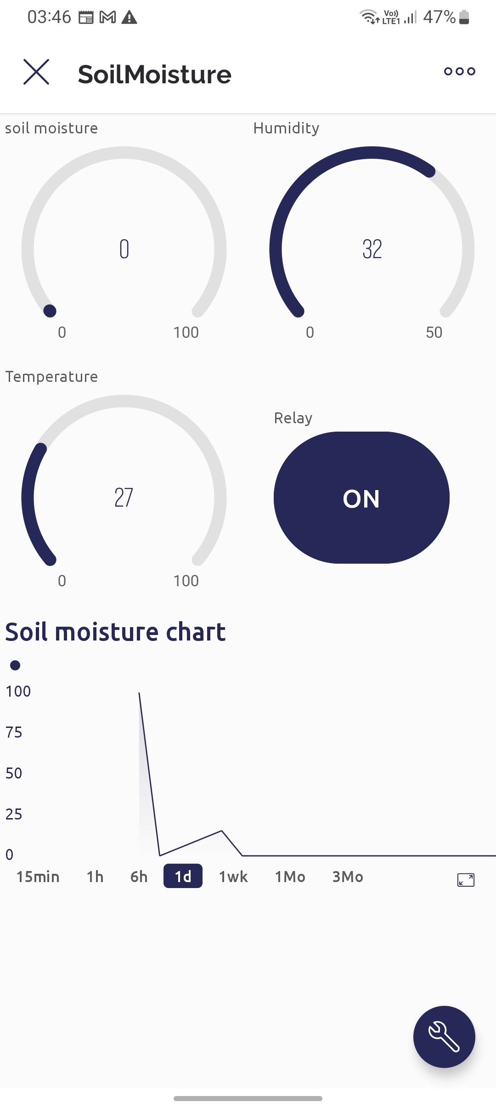
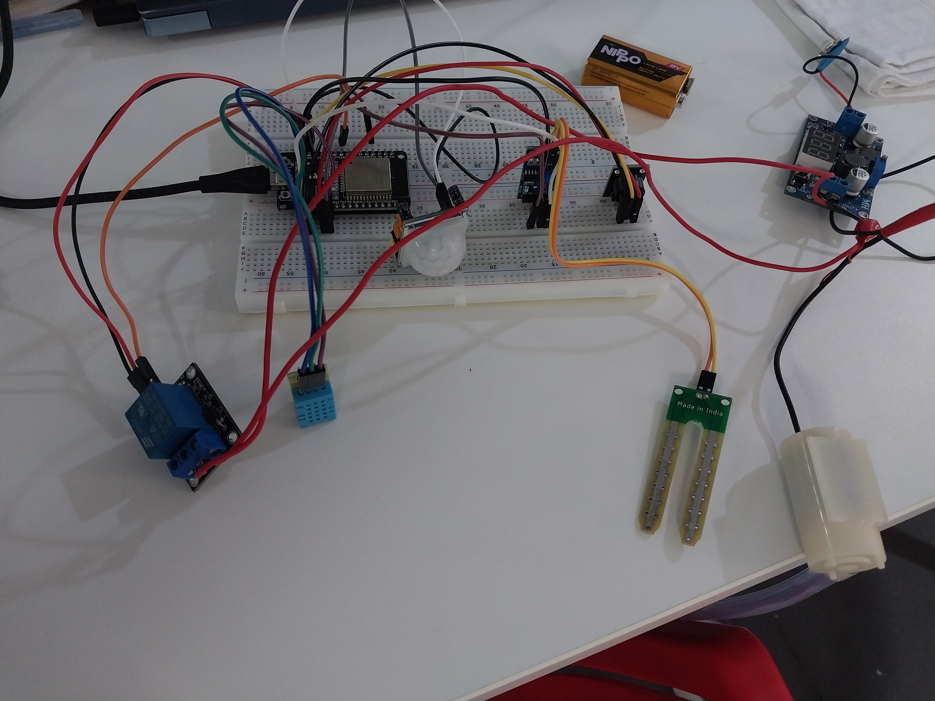
DEMO
Let us see the demo now.

Slide 15
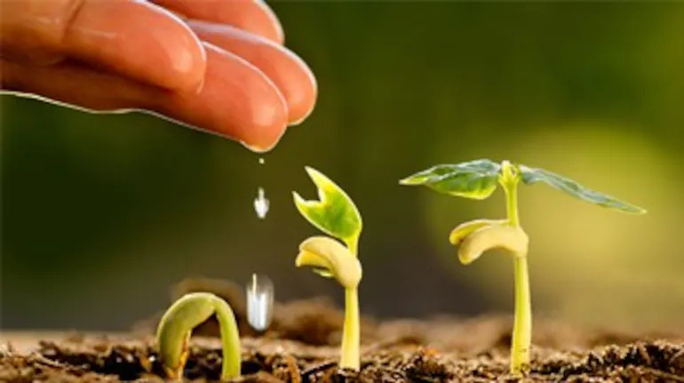
Thank You
- By AgroTech

